Slide 1
RDMA accelerating Redis
East China Normal University
2018年10月13号

Slide 2
Content
1. Introduction
2. Redis master-slave based on RDMA
3. Experimental environment and Results

Slide 3
1. Introduction

Slide 4
Background
You can initiate master-slave mode in Redis by specifying slaveof in configuration file or run slaveof command in the terminal. Then Redis in slave will replica all the data from the master.
The process of slaveof command is as follows:
The slave runs slaveof command and then sends requests to master.
The master dump all in-memory key-value pairs into a local disk file after receiving request for synchronization. Then, master starts a thread to send the file in disk to slave using network.
The slave load the data into local Redis after receiving the file.

Slide 5
Problems
There are two challenges in the process:
The master dump the data from memory to disk and send out later which incurs the unbearable overhead of Read/Write disk especially when a large amount of data stored in redis. We found that the time for writing the disk during the synchronization occupied more than half of the total time when the master network performance is good.
The master is responsible for sending data to all clients which incurs high overload to network and CPU of master. When a large number of slaves request at the same time, the master's network load increases and the network transmission performance decreases seriously.
master-slave replication process

Slide 6
Solution
For the two problems we mentioned above, we implemented a new master-slave synchronization scheme using RDMA.
The master creates a in-memory mapping table as buffer for Redis, which saves the time overhead for the master to write data to the disk. And the mapping table can fully take advantage of the RDMA's performance.
The slave uses the RDMA read to read the data in mapping table in synchronization. Due to the characteristics of RDMA one-sided operation, when multiple slaves read the data of the master's mapping table through RDMA, it does not incur a performance load on the master.

Slide 7
2. Redis master-slave
based on RDMA

Slide 8
We implemented an master-slave synchronization solution by using RDMA.
There are two techniques which greatly improved performance:
Mapping table
The mapping table is composed of consecutive fixed-size data areas. The master maps the key-value stored in the memory to the mapping table, and the slave obtains data from the mapping table.
RDMA one-sided operation
All slaves using RDMA read read data from the master memory in parallel, without incurring network competition.:

Slide 9
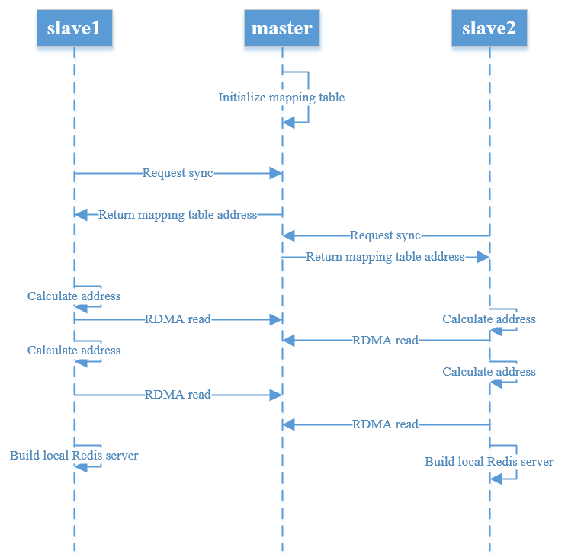
The main reasons for the performance improvement are as follows:
The data transfer between master and slave is via RDMA read.
The master's data does not be written to disk.
The slave calculates the address of the data on the mapping table by adding the starting address, and directly reads the data from the master memory area by using RDMA read.

Slide 10
Benefits from RDMA
The master-slave synchronization scheme implemented by RDMA has outstanding performance. The performance of master and slave synchronization is not affected by the number of slaves, which benefits from RDMA read one-sided operation.
In the Redis TCP master-slave model, the master sends the file in the disk to all slaves. The more slaves, the greater the network pressure of the master and the worse the performance of the transmission. However, the RDMA master-slave hands over the task of acquiring data to the slave. With the RDMA unilateral operation and the kernel-bypass feature, the performance of data synchronization will hardly be affected no matter how many slaves.

Slide 11
3. Experimental environment and Results

Slide 12
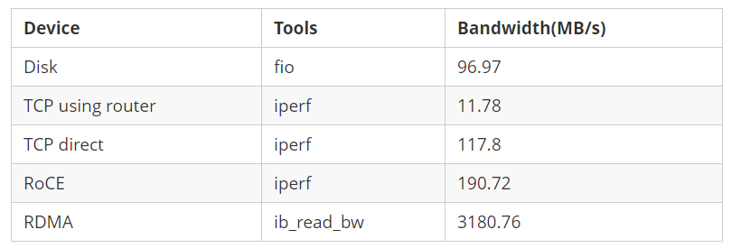
Experimental Environment
The experimental environment is as follows:
Ethernet network with routers
Ethernet network with cable directly
RoCE
RDMA Verbs
The master's Redis server stores a total of 937MB of data.

Slide 13
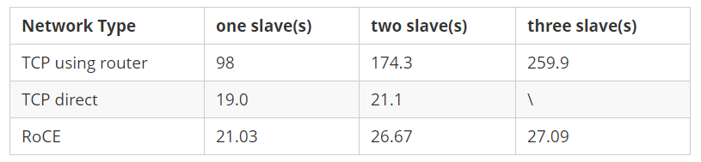
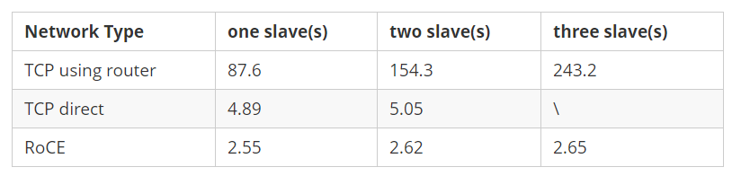
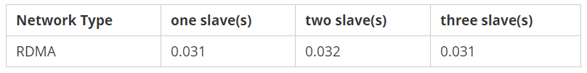
Synchronization time
Synchronization time with disk writing
Synchronization time without disk writring
Synchronization time using RDMA

